Slide 1

Classifying Party Representation Intro to Data Science and Machine Learning Universon Van Youssef Mroue

Slide 2
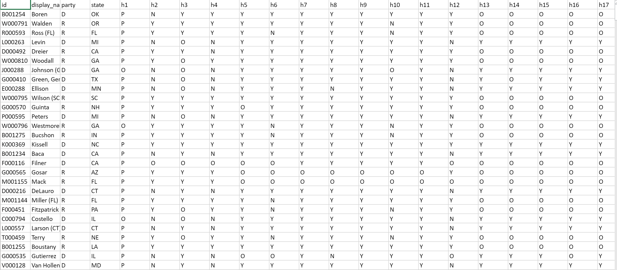
THE DATA SET
2ND SESSION OF THE 112TH CONGRESS (2012).
Source
After countless data compiling and cleaning we managed to create a csv file of all the votes of every representative on all the different bills presented in the session.
We then proceeded to convert the votes to numerical data.

Slide 3
What were we looking for?
If house representatives accurately represent their party or not based off their votes.

Slide 4
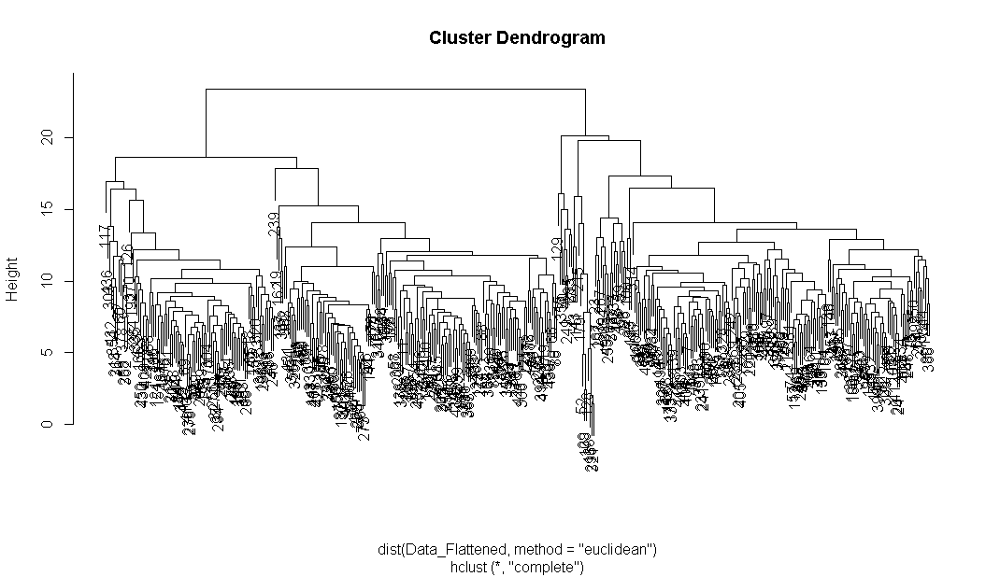
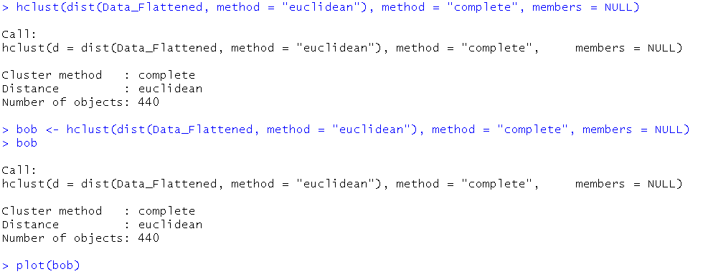
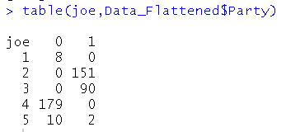
WHAT WE FOUND OUT
WHAT WE FOUND OUT

Slide 5
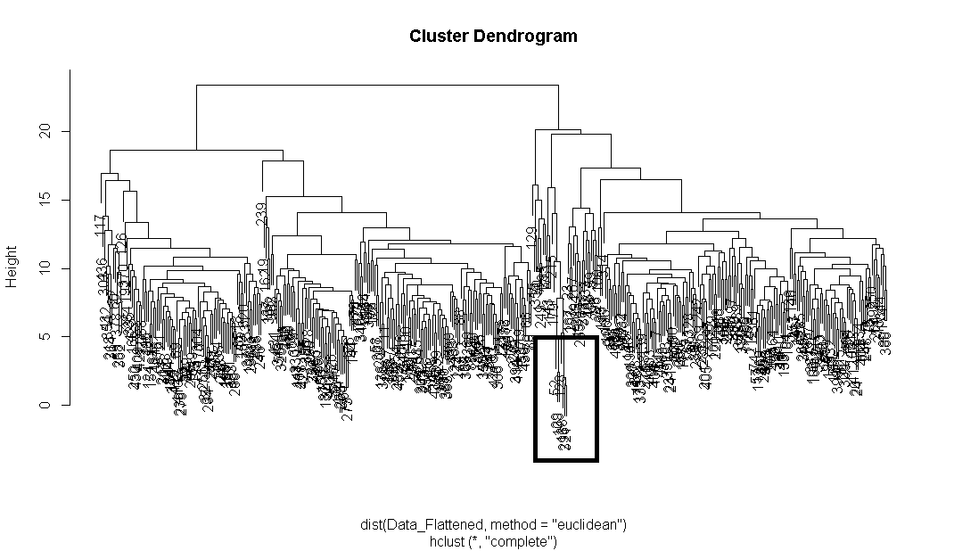
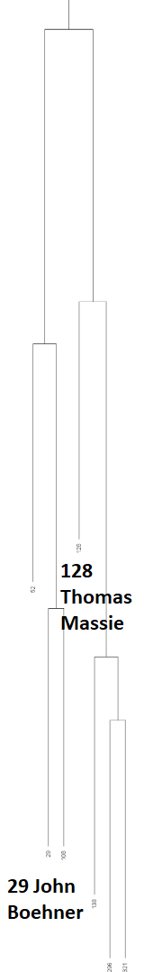

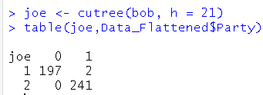
WHAT WE FOUND OUT
WHAT WE FOUND OUT

Slide 6
THE NEXT STEP
K means clustering
Model comparison
Silhouttes
Attempt same models on different data set with more diverse party representatives (Libertarian, Independent, etc)

